Slide 1
Mathematical Foundations of Groundwater Flow and Transport Modeling
©Ken Rainwater, Ph.D., P.E., BCEE
Texas Tech University
CECE Department

Slide 2
Soil/Sediment Description
Soil type based on particle diameters (d)
  clay -- d < 0.002 mm
    inorganic minerals, surface charge (-)
  silt -- 0.002 mm < d < 0.0625 mm
    inorganic and organic materials
  sand -- 0.0625 mm < d < 2 mm
    inorganic materials
  gravel -- d > 2 mm
Often have mixtures
  name in terms of dominant type

Slide 3
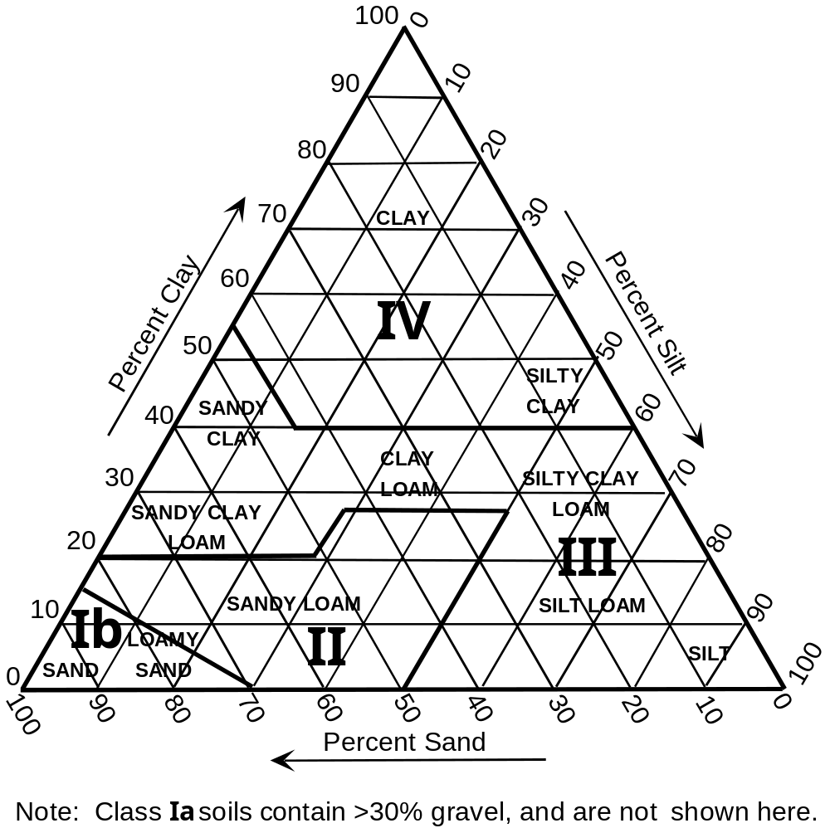
Soil Characterization Triangle

Slide 4
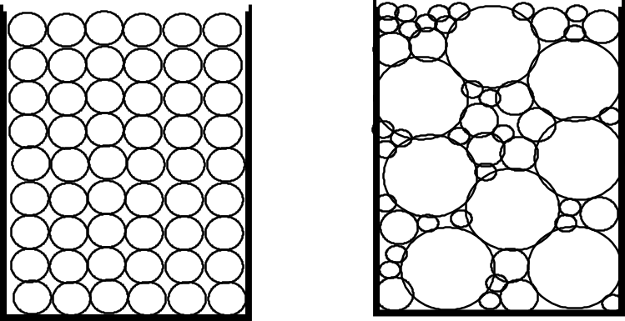
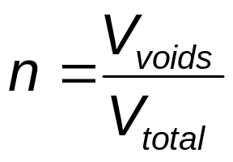
Pore Space Volume
Porosity (n) based on volume (V) ratio
  grain-size distribution
  packing, sorting, cementation (caliche)

Slide 5
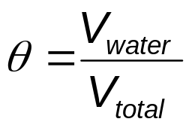
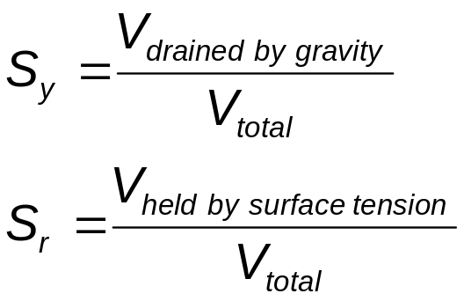
Porosity-Related Parameters
Moisture content
Effective porosity (n_{e})
  uses volume of connected voids
Specific yield (S_{y}), specific retention (S_{r})
  consider soil volume initially saturated with water, then allow water to drain by gravity

Slide 6
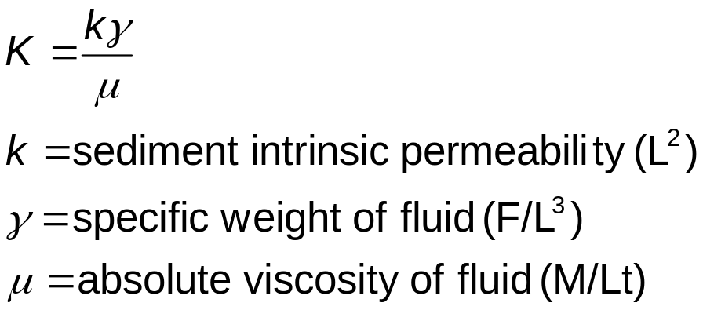
Ability to Transmit Water
Hydraulic conductivity (K) (L/t)
  typical units ft/d, m/d, cm/sec, gpd/ft²
  measurements
    laboratory (permeameters)
    field (slug and pump tests)
  related to sediment and fluid properties

Slide 7
Subsurface Zones
Saturated zone -- water fills all pores
Unsaturated (vadose) zone -- air shares pore space (K changes with θ)
Aqui______
  aquifer - saturated, K high enough for water to flow to wells
  aquitard - saturated, low K, low flow (clay)
  aquifuge - K = 0, no flow or storage (rock)

Slide 8
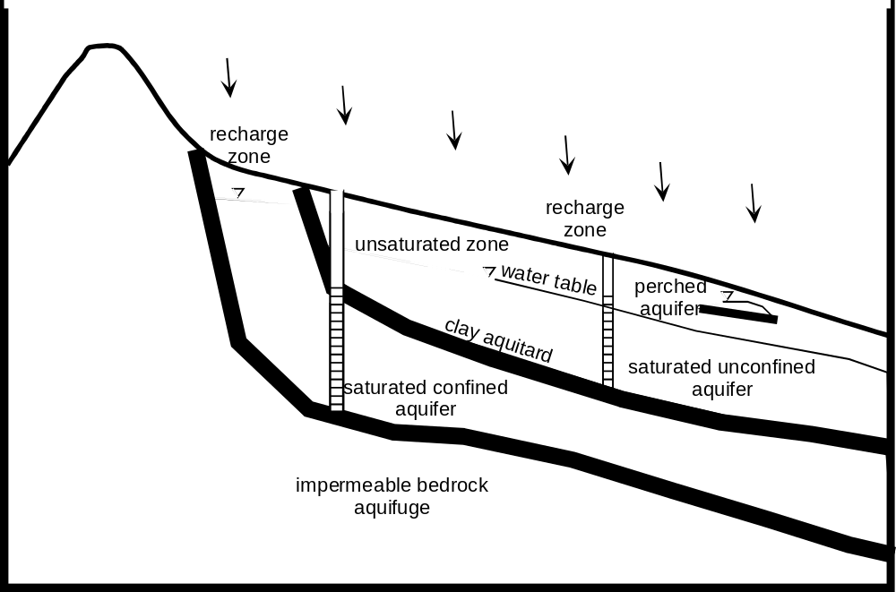
Describing the Subsurface

Slide 9
Hydraulic Descriptions
Flow is from high head (h) to low head
Water surface elevation
  Unconfined
    “water table” or top of saturated zone
  Confined
    elevation of water in well tapping the aquifer
Saturated thickness (b)

Slide 10
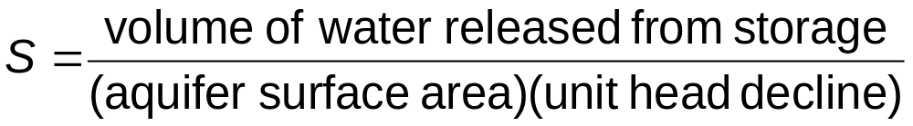

Hydraulic Description
Storage coefficient or storativity (S)
  S_{y} for unconfined (0.005 < S_{y} < n)
  function of porosity, aquifer and water compressibility for confined (S < 0.005)
Transmissivity (T) (L²/t)

Slide 11
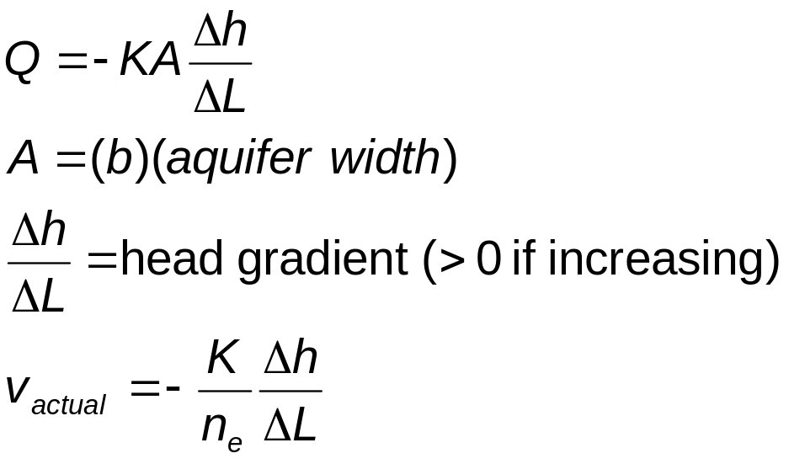
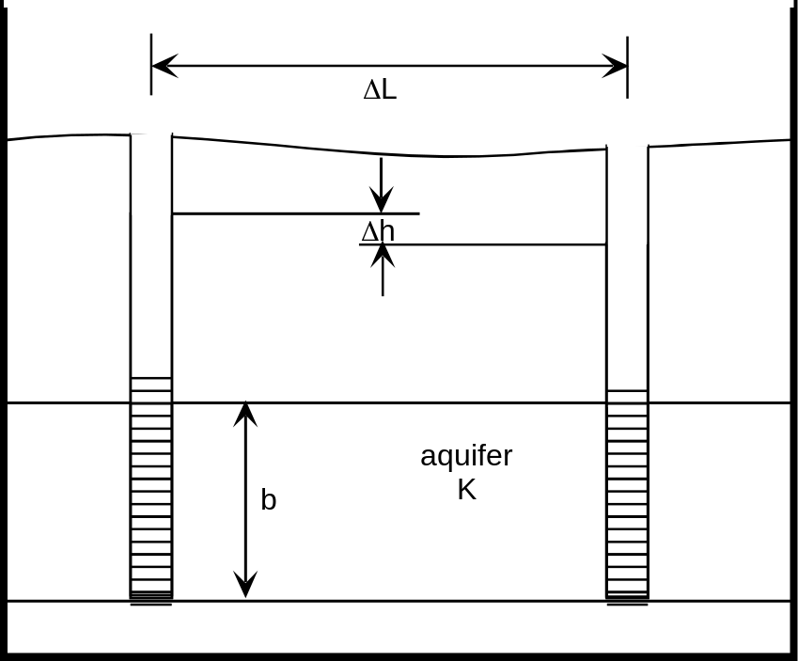
Darcy’s Law, Saturated Flow
Flow rate relates to K and head
1-D, 2-D, 3-D

Slide 12
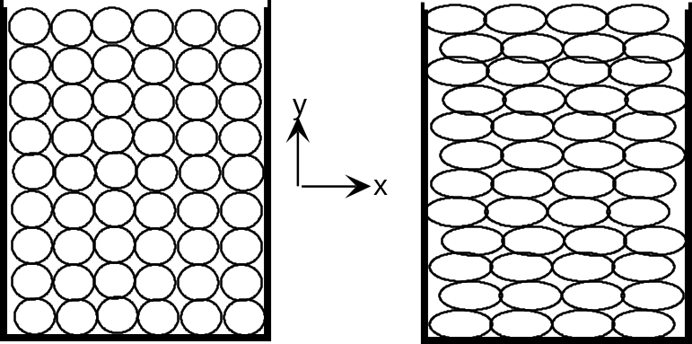
Hydraulic Parameter Variations
Homogeneous - same value at all points
  opposite - heterogeneous
  K often heterogeneous, different materials
Isotropic - same value in all directions
  opposite - anisotropic (K_{x} ≠ K_{y} ≠ K_{z})
  can affect K due to deposition, shapes

Slide 13
Hydraulic Parameter Variations
Variable geologic conditions
  affect K, S, n
  multiple layers with different materials
    aquifers, aquitards
  changes within a layer
    alluvial formations have buried stream channels (like Ogallala)
    layers do not usually have horizontal upper and lower surfaces

Slide 14
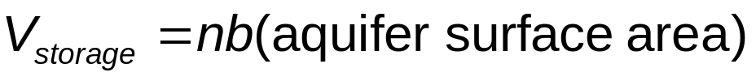
Hydrologic Conditions
Inputs to subsurface
  recharge
    rain infiltration, artificial recharge, return flow
Withdrawals from subsurface
  discharge
    evaporation if shallow, spring flow, pumping
Storage in aquifer
Aquifer boundaries
  recharge (like river), no flow (like foothills)

Slide 15
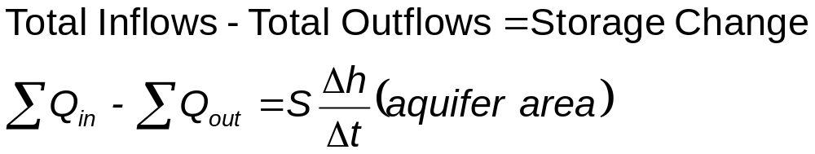
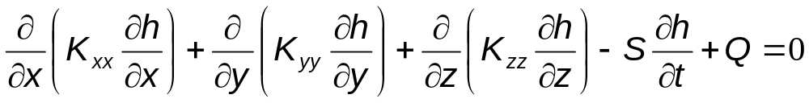
Conceptual Flow Equation
For time step Δt in modeled aquifer(s)
Partial differential equation (3-D)
Solution
  head distribution in space and time
  apply Darcy’s Law to get local velocities

Slide 16
Sources of Hydraulic Parameters
Lab tests - K, n
Field tests - K, S, T
Scientific literature
  look for similar site geology
Model calibration of field observations
  monitoring well head data at multiple locations over multiple times
  need good inflow and outflow records
  use trial-and-error to fit model output to observed data

